Slide 1
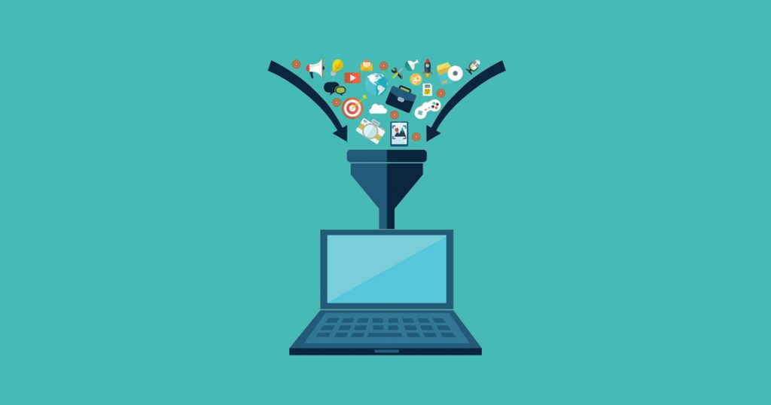
Data Collection
Lecture 3

Slide 2

Data Collection
There several ways to collect data:
Using existing datasets
Create/Simulate your own dataset
Using Web scraping
Using API

Slide 3
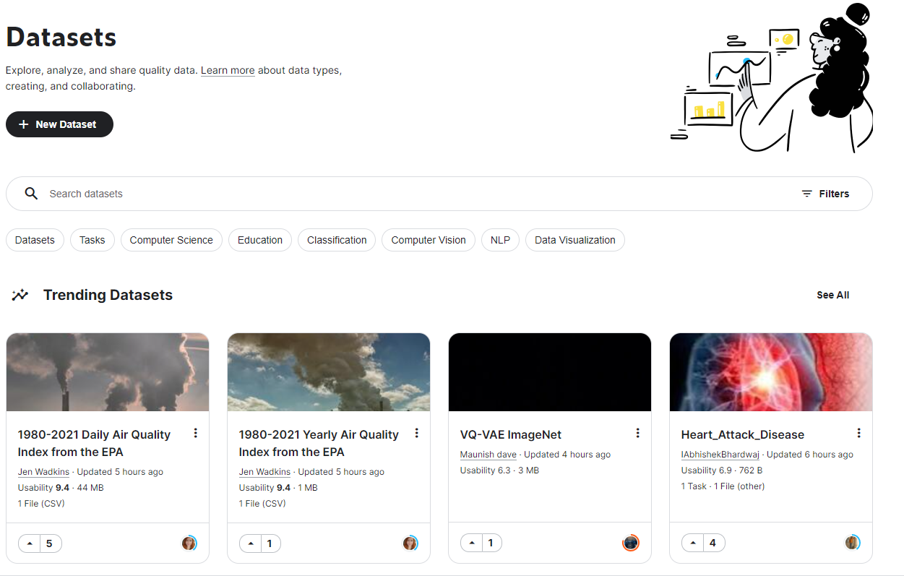

pushshift
Notes:
Using existing datasets

Slide 4
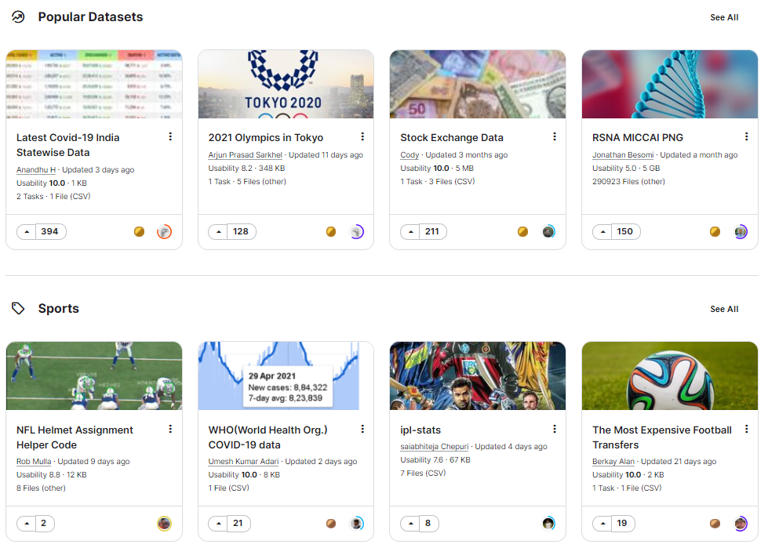
Notes:
Using existing datasets

Slide 5
Create/Simulate your own dataset
In cases there are no available datasets to us, we are required to generate or simulate our dataset.
Examples:
Creation of cloud computing testbed
Creation of Spoken Names Dataset.

Slide 6

Cloud Computing
Cloud servers are accessed over the Internet.
Cloud servers are located in data centers all over the world.
Users and companies don't have to manage physical servers themselves or run software applications on their own machines.

Slide 7
Cloud Computing advantages
Reduced IT costs
Scalability
Collaboration efficiency
Flexibility of work practices
Data backup and recovery

Slide 8
Cloud Computing Problems
However, alongside the reduction in IT costs, moving to cloud raises new threats that cyber experts should take into their considerations.
In addition, cyber experts have limited resources, thus they cannot secure all assets in the cloud.

Slide 9
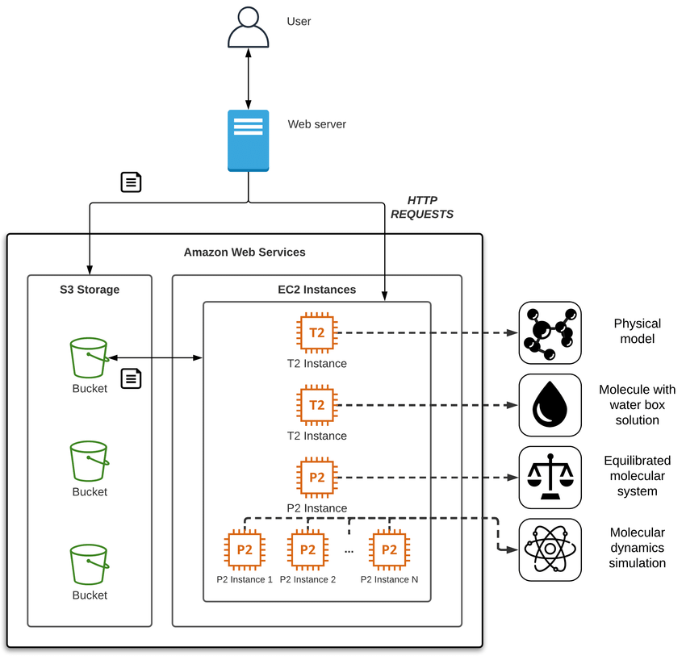
Create/Simulate your own dataset

Slide 10






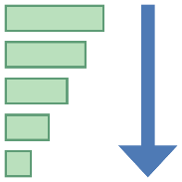
SpokenName2Vec Methodology
1
2
3
4
5
NAME
COLLECTION
SPEECH SEGMENT
GENERATION
SPOKEN NAME
EMBEDDING GENERATION
DISTANCE
COMPUTATION

Slide 11

Create/Simulate your own dataset
WikiTree Dataset
more than 17 million profiles and more than 250,000 unique forenames
Spoken Name Dataset
consists of 11 different languages:
American English,
French,
Spanish,
Italian,
Chinese,
Russian,
Ukrainian,
Latin,
Greek,
German, and
Portuguese.
Each language includes 250,000 WAV files reflecting the forenames in the WikiTree dataset.

Slide 12
Web Scraping
We can collect data using web scraping using one of the following methods:
Using simple tools like wget
Using Selenium for dynamic loaded pages
Using web scraping frameworks like Scrapy
Writing your own code

Slide 13
Wget
GNU Wget is a free software package for retrieving files using HTTP, HTTPS, FTP and FTPS, the most widely used Internet protocols.
It is a non-interactive command line tool, so it may easily be called from scripts, terminals without X-Windows support, etc.
https://colab.research.google.com/drive/1LgS_i9xwioLZb575I2v9yT0taalncNpX?usp=sharing

Slide 14
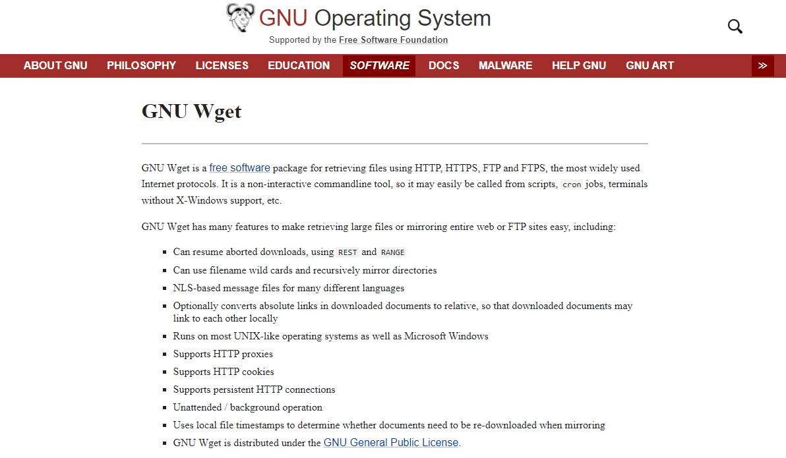
Wget

Slide 15

Selenium
Selenium is a portable framework for testing web applications.
Selenium provides a playback tool for authoring functional tests.
The tests can then run against most modern web browsers.
Selenium runs on Windows, Linux, and macOS. It is open-source software released under the Apache License 2.0.

Slide 16
Scrapy
An open source and collaborative framework for extracting the data you need from websites.
In a fast, simple, yet extensible way.

Slide 17

BeautifulSoup
Beautiful Soup is a Python package for parsing HTML and XML documents (including having malformed markup, i.e. non-closed tags, so named after tag soup).
It creates a parse tree for parsed pages that can be used to extract data from HTML, which is useful for web scraping.
Notes:
https://colab.research.google.com/drive/13gJh-sqq2ChfRiO3MpRWLYabFkZ4DrHf?usp=sharing

Slide 18
BeautifulSoup (Demonstration)
https://colab.research.google.com/drive/13gJh-sqq2ChfRiO3MpRWLYabFkZ4DrHf?usp=sharing
https://surnames.behindthename.com/name/williams/related
Notes:
https://colab.research.google.com/drive/13gJh-sqq2ChfRiO3MpRWLYabFkZ4DrHf?usp=sharing

Slide 19


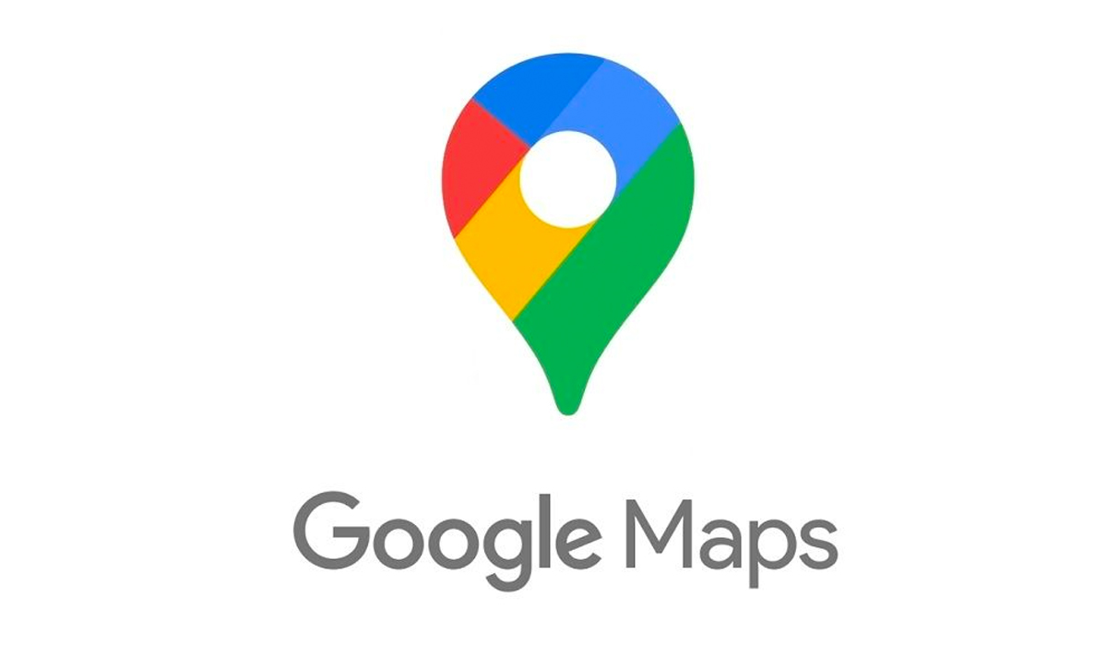
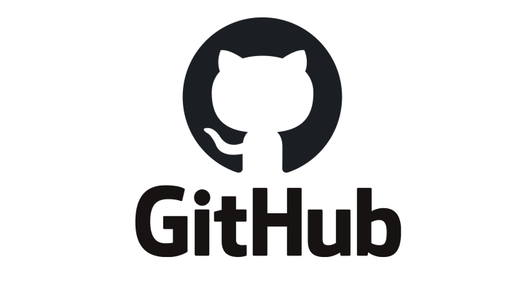
Application Programming Interfaces (APIs)
We can use various websites’ Application Programming Interfaces (APIs) to collect data from various platforms, such as:
Twitter
Reddit
Google Maps
Kaggle
GitHub
Notes:
https://colab.research.google.com/drive/13gJh-sqq2ChfRiO3MpRWLYabFkZ4DrHf?usp=sharing

Slide 20

Twitter (Demonstration)
https://colab.research.google.com/drive/1pFkbwAWCBny267vb9DOEUieis-ivru_1?usp=sharing
Notes:
https://colab.research.google.com/drive/13gJh-sqq2ChfRiO3MpRWLYabFkZ4DrHf?usp=sharing

